Slide 1

Big Data Integration – Moustapha, Mohamad and Kazem – March 2021

Slide 2
The family of NoSQL DBs
Key-values Stores
Hash table where there is a unique key and a pointer to a particular item of data.
Focus on scaling to huge amounts of data
E.g. Oracle BDB
Column Family Stores
To store and process very large amounts of data distributed over many machines
E.g. Cassandra, HBase
Document Databases
Collections of Key-Value collections
The next level of Key/value, allowing nested values associated with each key.
Appropriate for Web apps.
E.g. CouchDB, MongoDb
Graph Databases
Bases on property-graph model
Appropriate for Social networking, Recommendations
E.g. Neo4J, Infinite Graph

Slide 3
CAP theorem
Consistency:
means that when two users access the system at the same time they should see the same data.
Availability:
means up 24/7 and responds in a reasonable time.
Partition Tolerance:
means if part of the system fails, it is possible for the system as a whole to continue functioning

Slide 4
MongoDB profile
Document-oriented NoSQL database.
Schema-free.
Based on Binary JSON; BSON
Organized in Group of Documents → Collections
Informal namespacing
Auto-Sharding in order to scale horizontally.
Simple query language. Rich, document-based queries.
Map/Reduce support
Open Source (GNU AGPL v3.0.)
Name comes from “Humongous” & huge data
Written in C++, developed in 2009
Creator: 10gen, former doublick

Slide 5
MongoDB Data model
Data as Documents
Stored in BSON (Binary JSON)
Viewed and Read in JSON
Collection(Similar to table )
Data for a given record in a single document
Dynamic Schema
Documents can vary in structure
Fields can vary from document to document
Document are self-describing
New fields, collections can be created without affecting all other documents in the system.

Slide 6
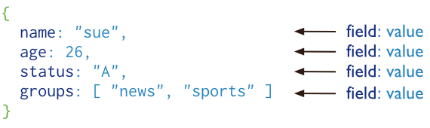
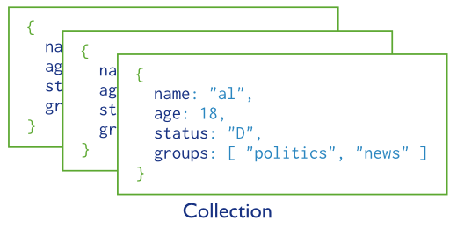
Collection and Documents
users

Slide 7
Terminology
RDBMS |  | MongoDB
Table, View | ➜ | Collection
Row | ➜ | Document
Index | ➜ | Index
Join | ➜ | Embedded Document
Foreign Key | ➜ | Reference
Partition | ➜ | Shard

Slide 8
ERD, Mongo Vs RDB

Slide 9
MongoDB with Big Data

Slide 10
Sharding
database
Partition data
Scale write throughput
Increase capacity
Auto-balancing
splitting
shard1
shard2
shard3

Slide 11
Replication
Redundancy and Fail-over
Zero downtime for upgrades and maintenance
Geo-spatial Features
Master-slave Replication
Peer-to-Peer Replication
Shard
abc
Copying
Abc
Abc
Abc

Slide 12
Combined Sharding and Replication
Sharding with Master-slave
Sharding with Peer-to-Peer
Advantages:
Data availability
Partition Tolerance

Slide 13
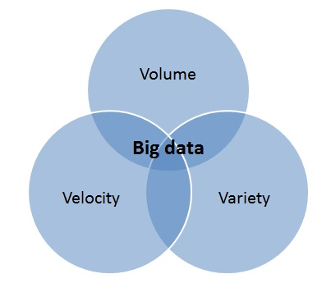
Big Data 3 vectors
Volume:
Petabytes
Exabytes
Zettabytes
Velocity:
Batch
Streaming Data
Variety:
Structures
Semi-Structures
Unstructured
Notes:
Do you have somewhere a large set of uncontrolled, unstructured, data that you are trying to fit into a RDBMS?
Log Analysis
Social Networking Feeds (many firms hooked in through Facebook or Twitter)
External feeds from partners
Data that is not easily analyzed in a RDBMS such as time-based data
Large data feeds that need to be massaged before entry into an RDBMS

Slide 14
Why MongoDB is suitable for Big Data
Data Types | Architectures | Data Volume
Unstructured data | Horizontal Scaling | Petabytes of data
Semi-structured data | Commodity Servers | Trillions of records
Polymorphic data | Cloud Computing | Millions of queries per second

Slide 15
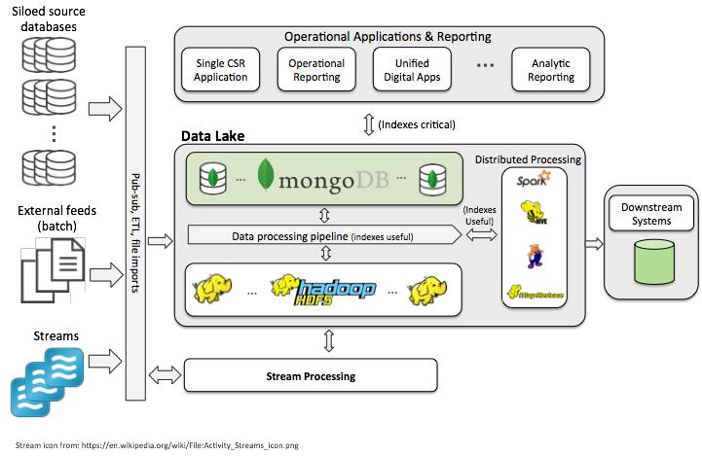
MongoDB In a Big Data Architecture

Slide 16
MongoDB in Practice

Slide 17
Manipulating Documents
CRUD Operations:
Add
Remove
Update
Find
Projection

Slide 18

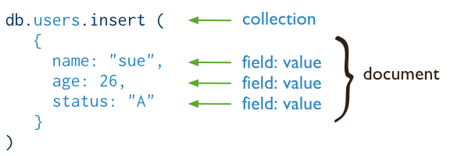
CRUD operations - create
Insert a new user.
SQL
MongoDB

Slide 19
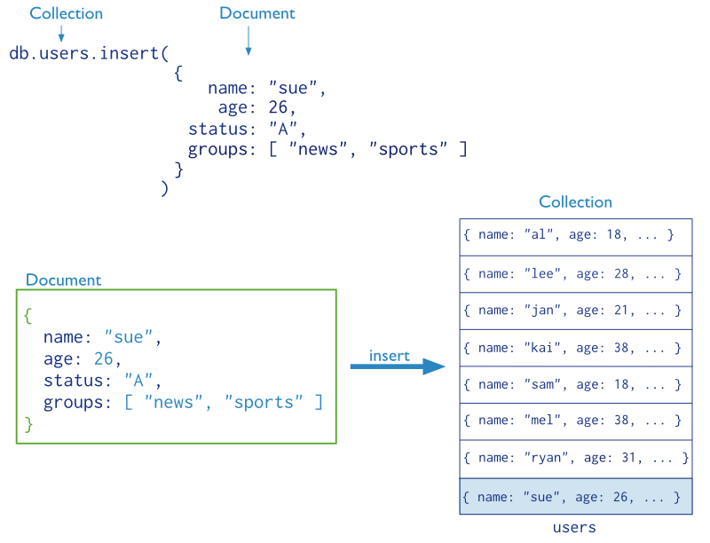
CRUD operations – create (cont’d)
©MongoDB [3]

Slide 20
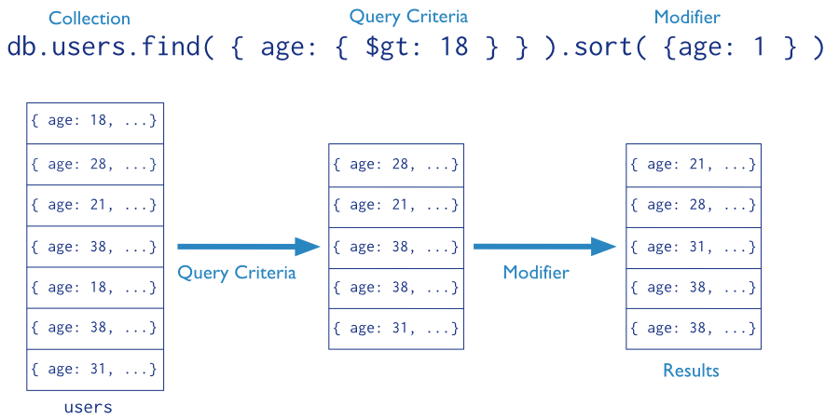
CRUD operations - read
Find the users of age greater than 18 and sort by age.

Slide 21

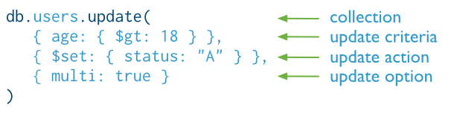
CRUD operations - update
Update the users of age greater than 18 by setting the status field to A.
SQL
MongoDB

Slide 22

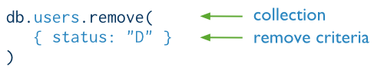
CRUD operations - delete
Delete the users with status equal to D.
SQL
MongoDB

Slide 23
Features
Written in C++
Extensive use of memory-mapped files
Runs nearly everywhere
Data serialized as BSON (fast parsing)
Full support for primary & secondary indexes
Document model = less work
Ad Hoc queries
Real time aggregation
Rich query capabilities
Traditionally consistent
Geospatial features
Support for most programming languages
Flexible schema

Slide 24
Thank you

